Slide 1
INTRODUCTION
PROJECT OBJECTIVE:
The main objective of this project is to design and implement an efficient system with the combination of both robot as well as the video capturing device. This can introduce an advance technology of live streaming along with the user commands that is linked to the movement of the robot. The usage of the Arduino in this project, not only reduces the complexity of the project but also results in the same efficiency of working.
PROJECT OVERVIEW:
The main aim of the project is to provide a robotic vehicle equipped with a wireless camera having capability for remote monitoring purposes. The camera allows for transmitting real time video at any conditions. Whatever is captured by the camera can be viewed in PC for reference.It can also be used in other environments where humans cannot possibly enter.

Slide 2
ABSTRACT
The main objective behind this project is to develop a robot to perform the act of surveillance in domestic areas. Nowadays robot plays a vital role in our day to day life activities thus reducing human labour and human error. Robots can be manually controlled or can be automatic based on the requirement. The purpose of this robot is to roam around and provide video information from the given environment and to livestream that obtained information to the user. In this project, one can control the robot with the help of mobile or laptop through Internet of Things (IoT) and also can get the live streaming of video both in daytime as well as at night with the help of wireless camera from the robot. The robot can be controlled manually with the help of Arduino microcontroller. Along with the obtained live streamed video output, user can also obtain the presence of any unusual activities through this. Thus the action of surveillance can be performed. Further advancement in our project can provide surveillance even in defense areas.

Slide 3
Embedded Systems
As its name suggests, Embedded means something that is attached to another thing. An embedded system can be thought of as a computer hardware system having software embedded in it. An embedded system can be an independent system or it can be a part of a large system. An embedded system is a microcontroller or micro- processor-based system which is designed to perform a specific task. For example, a fire alarm is an embedded system; it will sense only smoke.
An embedded system has three components −
It has hardware.
It has application software.
It has Real Time Operating system (RTOS) that supervises the application software and provide mechanism to let the processor run a process as per scheduling by following a plan to control the latencies. RTOS defines the way the system works. It sets the rules during the execution of application program. A small scale embedded system may not have RTOS.
So we can define an embedded system as a Microcontroller based, software driven, reliable, real-time control system.
An embedded system is a computer system designed to perform one or a few dedicated functions often with real-time computing constraints. It is embedded as part of a complete device often including hardware and mechanical parts. By contrast, a general-purpose computer, such as a personal computer (PC), is designed to be flexible and to meet a wide range of end-user needs. Embedded systems control many devices in common use today.
Embedded systems are controlled by one or more main processing cores that are typically either microcontrollers or digital signal processors (DSP). The key characteristic, however, is being dedicated to handle a particular task, which may require very powerful processors. For example, air traffic control systems may usefully be viewed as embedded, even though they involve mainframe computers and dedicated regional and national networks between airports and radar sites. (Each radar probably includes one or more embedded systems of its own.) Since the embedded system is dedicated to specific tasks, design engineers can optimize it to reduce the size and cost of the product and increase the reliability and performance. Some embedded systems are mass-produced, benefiting from economies of scale.

Slide 4
Physically embedded systems range from portable devices such as digital watches and MP3 players, to large stationary installations like traffic lights, factory controllers, or the systems controlling nuclear power plants. Complexity varies from low, with a single microcontroller chip, to very high with multiple units, peripherals and networks mounted inside a large chassis or enclosure.
In general, "embedded system" is not a strictly definable term, as most systems have some element of extensibility or programmability. For example, handheld computers share some elements with embedded systems such as the operating systems and microprocessors which power them, but they allow different applications to be loaded and peripherals to be connected. Moreover, even systems which don't expose programmability as a primary feature generally need to support software updates. On a continuum from "general purpose" to "embedded", large application systems will have subcomponents at most points even if the system as a whole is "designed to perform one or a few dedicated functions", and is thus appropriate to call "embedded".
“Embedded Systems are devices which are used to control, monitor or assist the operation of an equipment, machinery or plant”.
A modern example of embedded system is shown in figure: 1.1.1

Slide 5
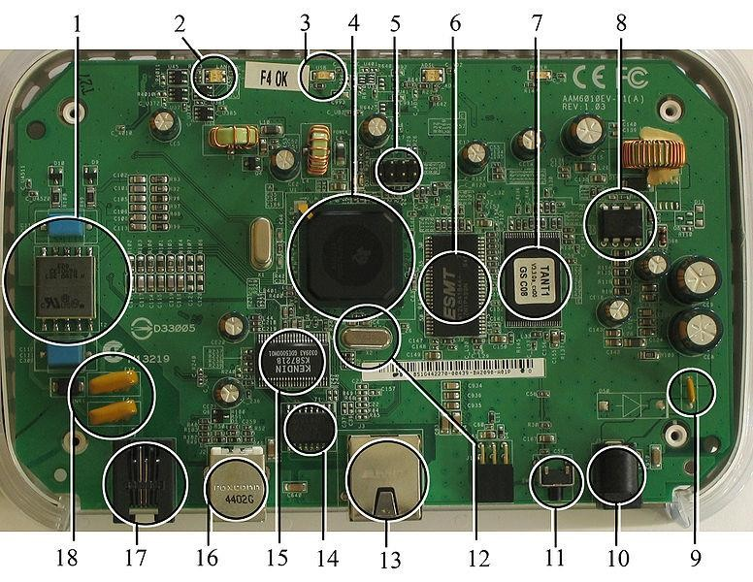
Figure 1.1.1:A modern example of embedded system
Labelled parts include microprocessor (4), RAM (6), flash memory (7). Embedded systems programming is not like normal PC programming. In many ways, programming for an embedded system is like programming PC 15 years ago. The hardware for the system is usually chosen to make the device as cheap as possible. Spending an extra dollar a unit in order to make things easier to program can cost millions. Hiring a programmer for an extra month is cheap in comparison. This means the programmer must make do with slow processors and low memory, while at the same time battling a need for efficiency not seen in most PC applications. Below is a list of issues specific to the embedded field.
The term “control”defines the main function of Embedded System because their purpose is to control aspect of a physical system such as pressure, temperature and so on. Also the term “monitor” defines the progress of activities.

Slide 6
Need For Embedded Systems:
The uses of embedded systems are virtually limitless, because every day new products are introduced to the market that utilizes embedded computers in novel ways. In recent years, hardware such as microprocessors, microcontrollers, and FPGA chips have become much cheaper. So when implementing a new form of control, it's wiser to just buy the generic chip and write your own custom software for it. Producing a custom-made chip to handle a particular task or set of tasks costs far more time and money. Many embedded computers even come with extensive libraries, so that "writing your own software" becomes a very trivial task indeed. From an implementation viewpoint, there is a major difference between a computer and an embedded system. Embedded systems are often required to provide Real-Time response. The main elements that make embedded systems unique are its reliability and ease in debugging.
Debugging:
Embedded debugging may be performed at different levels, depending on the facilities available. From simplest to most sophisticate they can be roughly grouped into the following areas:
Interactive resident debugging, using the simple shell provided by the embedded operating system (e.g. Forth and Basic)
External debugging using logging or serial port output to trace operation using either a monitor in flash or using a debug server like the Remedy Debugger which even works for heterogeneous multi core systems.

Slide 7
An in-circuit debugger (ICD), a hardware device that connects to the microprocessor via a JTAG or Nexus interface. This allows the operation of the microprocessor to be controlled externally, but is typically restricted to specific debugging capabilities in the processor.
An in-circuit emulator replaces the microprocessor with a simulated equivalent, providing full control over all aspects of the microprocessor.
Reliability:
Embedded systems often reside in machines that are expected to run continuously for years without errors and in some cases recover by themselves if an error occurs. Therefore the software is usually developed and tested more carefully than that for personal computers, and unreliable mechanical moving parts such as disk drives, switches or buttons are avoided.
Specific reliability issues may include:
The system cannot safely be shut down for repair, or it is too inaccessible to repair. Examples include space systems, undersea cables, navigational beacons, bore-hole systems, and automobiles.
The system must be kept running for safety reasons. "Limp modes" are less tolerable. Often backups are selected by an operator. Examples include aircraft navigation, reactor control systems, safety-critical chemical factory controls, train signals, engines on single-engine aircraft.

Slide 8
The system will lose large amounts of money when shut down: Telephone switches, factory controls, bridge and elevator controls, funds transfer and market making, automated sales and service.
A variety of techniques are used, sometimes in combination, to recover from errors—both software bugs such as memory leaks, and also soft errors in the
hardware:
Watchdog timer that resets the computer unless the software periodically notifies the watchdog
Subsystems with redundant spares that can be switched over to
software "limp modes" that provide partial function
Designing with a Trusted Computing Base (TCB) architecture [6] ensures a highly secure & reliable system environment
An Embedded Hypervisor is able to provide secure encapsulation for any subsystem component, so that a compromised software component cannot interfere with other subsystems, or privileged-level system software. This encapsulation keeps faults from propagating from one subsystem to another, improving reliability. This may also allow a subsystem to be automatically shut down and restarted on fault detection.
Immunity Aware Programming

Slide 9
Components of an Embedded System
An embedded system has three main components : Hardware, Software and time operating system
i) Hardware
Power Supply
Processor
Memory
Timers
Serial communication ports
Output/Output circuits
System application specific circuits

Slide 10
ii) Software:
The application software is required to perform the series of tasks.
An embedded system has software designed to keep in view of three constraints:
Availability of System Memory
Availability of processor speed
The need to limit power dissipation when running the system continuously in cycles of wait for events, run , stop and wake up.
iii) Real Time Operating System: (RTOS)
It supervises the application software, provides a mechanism to let the process or run aprocess as per scheduling alongdo the switching from one process (task) to an other process. With an RTOS, the processing time is measured in tenths of seconds.
This system is time-bound and has a fixed deadline. The processing in this type of system must occur within the specified constraints. Otherwise, This will lead to system failure. Examples of the real-time operating systems: Airline traffic control
systems, Command Control Systems, Airlines reservation system, Heart Pacemaker, Network Multimedia Systems, Robot etc.

Slide 11
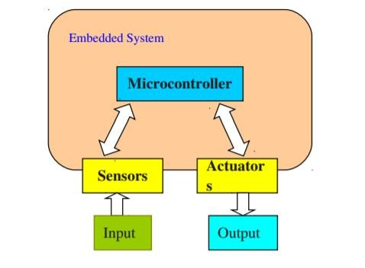
Block Diagram of an Embedded System
An Embedded System is a microprocessor based system that is embedded as a subsystem, in a larger system (which may or may not be a computer system). By contrast, a general-purpose computer, such as a personal computer (PC), is designed to be flexible and to meet a wide range of end-user needs.
An embedded system is a custom-built special purpose computer used for a specific purpose. It is a system that combines both hardware and software to perform a certain task.It can be used as an individual system or a part of another large system. You will find embedded systems incorporated in a range of applications including consumer electronics, industrial machinery, automobiles, agriculture, processing industrial devices, airplanes, digital watches, vending machines, air-conditioners, mobile devices.

Slide 12
System Requirements
Hardware Requirements
HARDWARE COMPONENTS USED: The major building blocks of this project are:
Regulated Power Supply.
ARDUINO Microcontroller.
LCD
DC MOTORS
L293D MOTOR DRIVER
Motherboard
ESP-32 Wi-Fi Camera module
Software Requirements
ARDUINO IDE for Embedded C programming.
ARDUINO IDE for compiler, dumping code into Micro controller.
Regulated Power Supply
A regulated power supply converts unregulated AC (Alternating Current) to a constant DC (Direct Current). A regulated power supply is used to ensure that the output remains constant even if the input changes the IC Regulated power supply (RPS) is one kind of electronic circuit, designed to provide the stable DC voltage of fixed value across load terminals irrespective of load variations. The main function of the regulated power supply is to convert an unregulated alternating current (AC) to a steady direct current (DC). The RPS is used to confirm that if the input changes then the output will be stable. This power supply is also called a linear power supply, and this will allow an AC input as well as provides steady DC output.
A power supply can be used for providing the necessary amount of power at the precise voltage from the main source like a battery. A transformer alters the AC mains voltage toward a necessary value and the main function of this is to step up and step down the voltage.

Slide 13
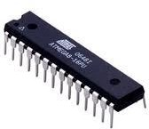
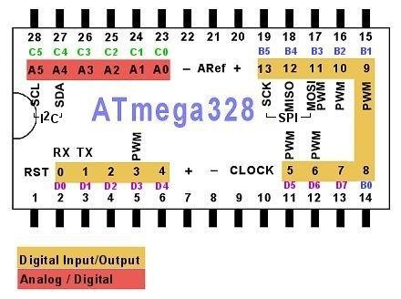
Arduino:
Pin Diagram

Slide 14
VCC:
Digital supply voltage magnitude of the voltage range between 4.5 to 5.5 V for the ATmega8 and 2.7 to 5.5 V for ATmega8L
GND:
Ground Zero reference digital voltage supply.
PORTB (PB7.. PB0) :
PORTB is a port I / O two-way (bidirectional) 8-bit with internal pull-up
resistor can be selected. This port output buffers have symmetrical characteristics when used as a source or sink. When used as an input, the pull-pin low externally will emit a current if the pull-up resistor is activated it. PORTB pins will be in the condition of the tri-state when RESET is active, although the clock is not running.
PORTC (PC5.. PC0) : PORTC is a port I / O two-way (bidirectional) 7-bit with internal pull-up resistor can be selected. This port output buffers have symmetrical characteristics
PC6/RESET:
If RSTDISBL Fuse programmed, PC6 then serves as a pin I / O but with different characteristics. PC0 to PC5 If Fuse RSTDISBL not programmed, then serves as input Reset PC6. LOW signal on this pin with a minimum width of 1.5 microseconds will bring the microcontroller into reset condition, although the
clock is not running.
PORTD (PD7.. PD0) :
PORTD is a port I / O two-way (bidirectional) 8-bit with internal pull-up resistor can be selected. This port output buffers have symmetrical characteristics
when used as a source or sink. When used as an input, the pull-pin low externally will emit a current if the pull-up resistor is activated it. PORTD pins will be in the condition of the tri-state when RESET is active, although the clock is not running

Slide 15
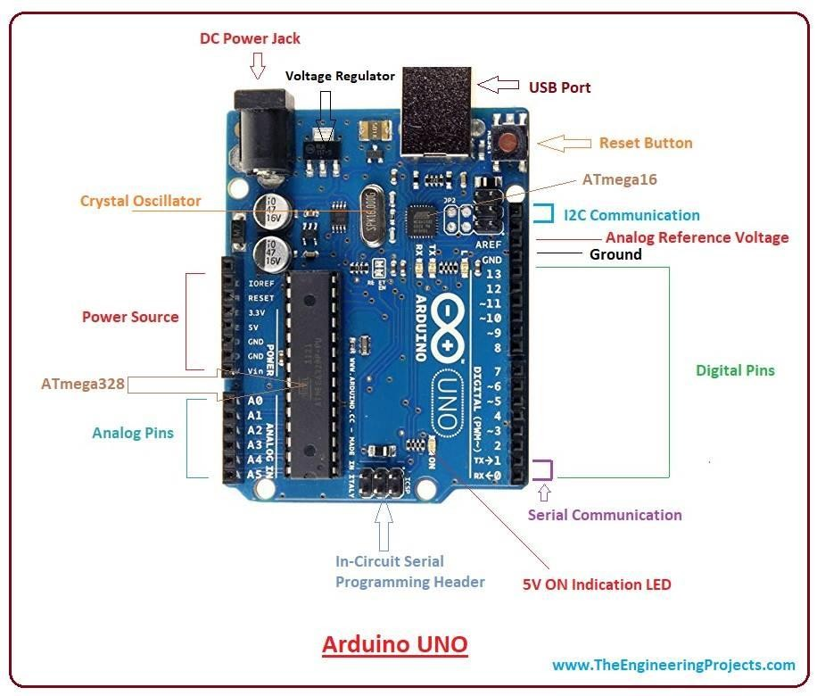
Figure 4.5.2.3 ARDUINO Development Board
Arduino provides open-source electronics prototyping platforms based on flexible, easy-to-use hardware and software. Arduino prototyping platforms are intended for artists, designers, hobbyists, and anyone interested in creating interactive objects or environments. Arduino's prototyping platforms can sense the environment
by receiving input from a variety of sensors and can affect their surroundings by controlling lights, motors, and other actuators. Arduino projects can be stand-alone or they can communicate with software running on a computer.

Slide 16
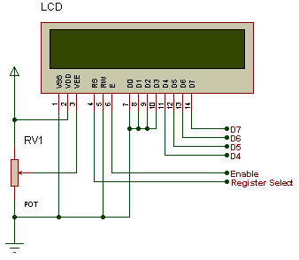
LCD:
One of the most common devices attached to a micro controller is an LCD display. Some of the most common LCD’s connected to the many microcontrollers are 16x2 and 20x2 displays. This means 16 characters per line by 2 lines and 20 characters per line by 2 lines, respectively.
Basic 16x 2 Characters LCD
LCD stands for Liquid Crystal Display. These displays contain a grid of liquid crystal dots, or pixels held between layers of glass etched with transparent electrodes. Liquid crystal molecules are normally twisted, but straighten out when electricity is applied to them.

Slide 17
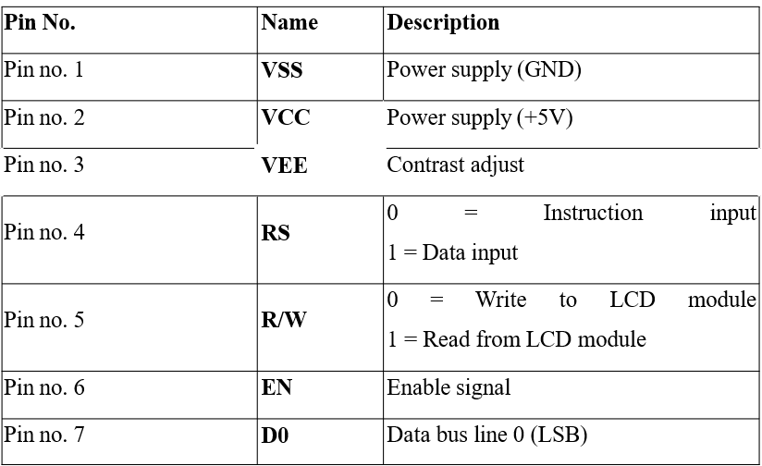
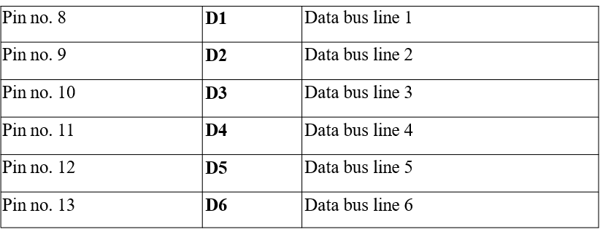

Slide 18
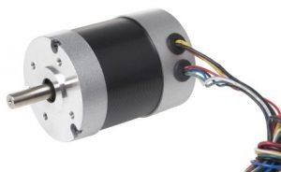
DC MOTOR
A DC motor is an electric motor that runs on direct current power. In an electric motor, the operation is dependent upon simple electromagnetism. A current-carrying conductor generates a magnetic field, when this is then placed in an external magnetic field, it will encounter a force proportional to the current in the conductor and to the strength of the external magnetic field. It is a device that converts electrical energy to mechanical energy.
It works on the fact that a current-carrying conductor placed in a magnetic field experiences a force that causes it to rotate with respect to its original position. Practical DC Motor consists of field windings to provide the magnetic flux and armature which acts as the conductor.
Figure 4.5.4.1 Brushless DC Motor

Slide 19
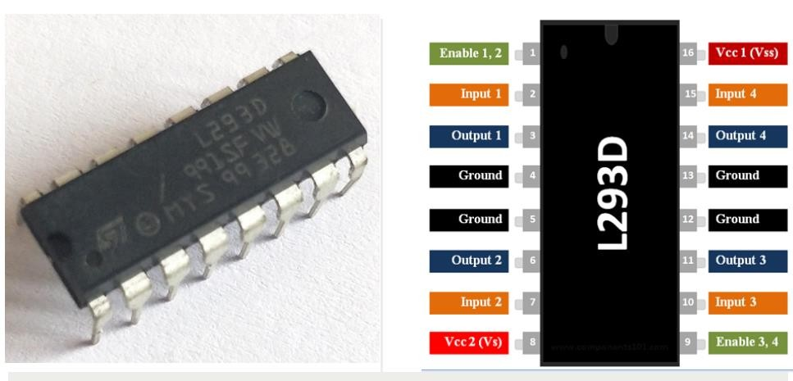
The DC motor has two basic parts: the rotating part that is called the armature and the stationary part that includes coils of wire called the field coils. The stationary part is also called the stator. Figure shows a picture of a typical DC motor, Figure shows a picture of a DC armature, and Fig shows a picture of a typical stator. From the picture you can see the armature is made of coils of wire wrapped around the core, and the core has an extended shaft that rotates on bearings. You should also notice that the ends of each coil of wire on the armature are terminated at one end of the armature. The termination points are called the commutator, and this is where the brushes make electrical contact to bring electrical current from the stationary part to the rotating part of the machine.
Operation:
The DC motor you will find in modem industrial applications operates very similarly to the simple DC motor described earlier in this chapter. Figure 12-9 shows an electrical diagram of a simple DC motor. Notice that the DC voltage is applied directly to the field winding and the brushes. The armature and the field are both shown as a coil of wire. In later diagrams, a field resistor will be added in series with the field to control the motor speed.
When voltage is applied to the motor, current begins to flow through the field coil from the negative terminal to the positive terminal. This sets up a strong magnetic field in the field winding. Current also begins to flow through the brushes into a commutator segment and then through an armature coil. The current continues to flow through the coil back to the brush that is attached to other end of the coil and returns to the DC power source. The current flowing in the armature coil sets up a strong magnetic field in the armature.
Motor Driver IC L293D is running on the basic principle of H-Bridge, IC L293D has two-channel it consist H-Bridge circuit in each channel therefore it’s known as Dual H-Bridge Motor Driver IC L293D.When Switch S1 & S4 Closed, a positive voltage is applied across the motor and it will rotate in a clockwise direction and when both switches are open, the motor will stop rotating.When Switch S2 & S3 Closed, an inverting voltage is applied at the terminals of the motor and it will rotate in an anti- clockwise direction and when both switches are open, the motor will stop rotating.
Figure 4.5.5.2 L293D Pin Configuration

Slide 20
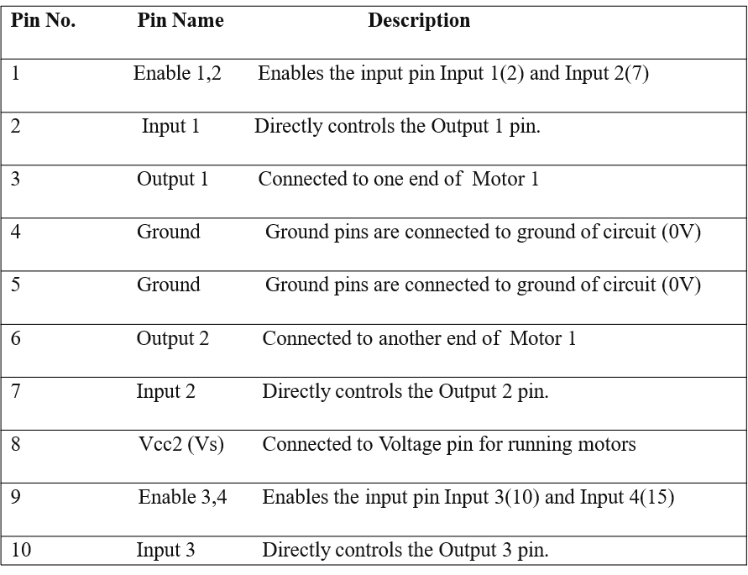
The L293D Pin Description is as follows

Slide 21
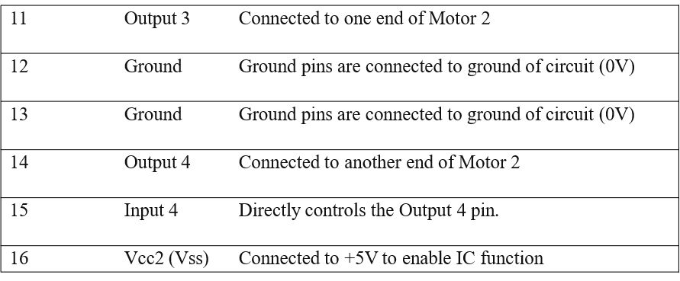
Features
Speed and Direction control is possible
Motor voltage Vcc2 (Vs): 4.5V to 36V
Maximum Peak motor current: 1.2A
Maximum Continuous Motor Current: 600mA
Supply Voltage to Vcc1(vss): 4.5V to 7V
Transition time: 300ns (at 5Vand 24V)
Automatic Thermal shutdown is available
Available in 16-pin DIP, TSSOP, SOIC package.

Slide 22
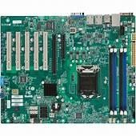
Motherboard
A motherboard (also called mainboard, main circuit board,[1] mb, mboard, backplane board, base board, system board, logic board (only in Apple PCs) or mobo) is the main printed circuit board (PCB) in general-purpose computers and other expandable systems. It holds and allows communication between many of the crucial electronic components of a system, such as the central processing unit (CPU) and memory, and provides connectors for other peripherals. Unlike a backplane, a motherboard usually contains significant sub-systems, such as the central processor, the chipset's input/output and memory controllers, interface connectors, and other components integrated for general use.Motherboard means specifically a PCB with expansion capabilities. As the name suggests, this board is often referred to as the "mother" of all components attached to it, which often include peripherals, interface cards, and daughterboards: sound cards, video cards, network cards, host bus adapters, TV tuner cards, IEEE 1394 cards; and a variety of other custom components

Slide 23
Motherboard Components and Their Functions
There are many components found in a motherboard. Some of them are major motherboard components while others are not. The following is a motherboard components list.
20 Major Motherboard Components
CPU (Central Processing Unit) chip
RAM (Random Access Memory) slots
Southbridge/northbridge
BIOS (Basic Input/Output System)
I/O port
USB (Universal Serial Bus)
CPU slot
PCI (Peripheral Component Interconnect) slot
AGP (Accelerated Graphics Port) slot
ISA (Industry Standard Architecture) slot
Parallel port
FDC (Floppy-Disk Controller)
IDE (Integrated Drive Electronics) controller
CMOS (Complementary Metal-oxide-semiconductor) battery
Power supply connector
Mouse and keyboard ports
DIP (Dual In-line Package) switch
Jumper
Heat sink/heatsink (cooling system)
Clock generator.

Slide 24
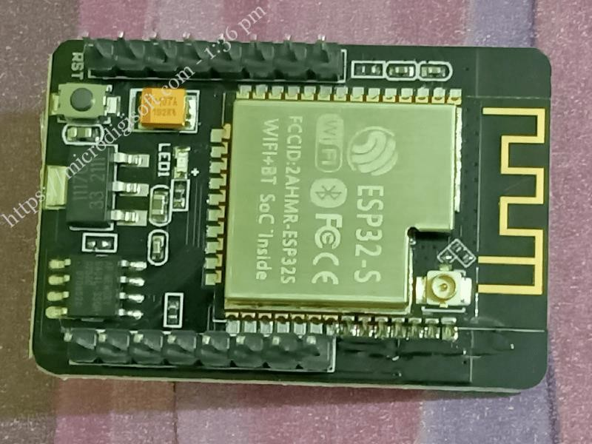
WIFI module
Wi-fi or wireless fidelity is most trending and highly used technology across the world. From television to mobile and from AC’s to home appliances, all are almost equipped with Wi-Fi. These modules vary from different size, configuration protocols etc.
ESP 32 CAMERA WI-FI MODULE
ESP32-CAM is a low-cost ESP32-based development board with Onboard camera, small in size. It is a solution for IoT application, prototypes constructions and DIY projects. The board integrates WIFI, traditional Bluetooth and low power BLE, with 2 high performance 32-bit LX6 CPUs. It adopts 7-stage pipeline architecture, on-chip sensor, Hall sensor, temperature sensor and so on, and its main frequency adjustment ranges from 80MHz to 240MHz
Figure 4.5.7.1 ESP 32 Wi-fi Camera Module
The ESP32-CAM is a very small camera module with the ESP32-S chip that costs approximately $10. Besides the OV2640 camera, and several GPIOs to connect peripherals, it also features a microSD card slot that can be useful to store images taken with the camera or to store files to serve to clients.
Fully compliant with Wi-Fi33 802.11b/g/n/e/I and Bluetooth 4.2 standards, it can be used as a master mode to build an independent network controller, or as a slave to other host MCUs to add networking capabilities to existing devices ESP32-CAM can be widely used in various IoT applications. It is suitable for home smart devices, industrial wireless control, wireless monitoring, QR wireless identification, wireless

Slide 25
positioning system signals and other IoT applications. It is an ideal solution for IoT applications.
The ESP32 camera development board is a WIFI+ Bluetooth dual-mode module that uses PCB on-board antennas and cores based on ESP32 chips. It can work independently as a minimum system.
Features
Ultra-small 802.11b/g/n Wi-Fi + BT/BLE SoC module
Low-power dual-core 32-bit CPU for application processors
Up to 240MHz, up to 600 DMIPS
Built-in 520 KB SRAM, external 4M PSRAM
Supports interfaces such as UART/SPI/I2C/PWM/ADC/DAC
Support OV2640 and OV7670 cameras with built-in flash
Support for images WIFI upload
Support TF card
Support multiple sleep modes
Embedded Lip and FreeRTOS
Support STA/AP/STA+AP working mode
Support Smart Config/Arikis One-click distribution network
Support for serial local upgrade and remote firmware upgrade (FOTA)

Slide 26
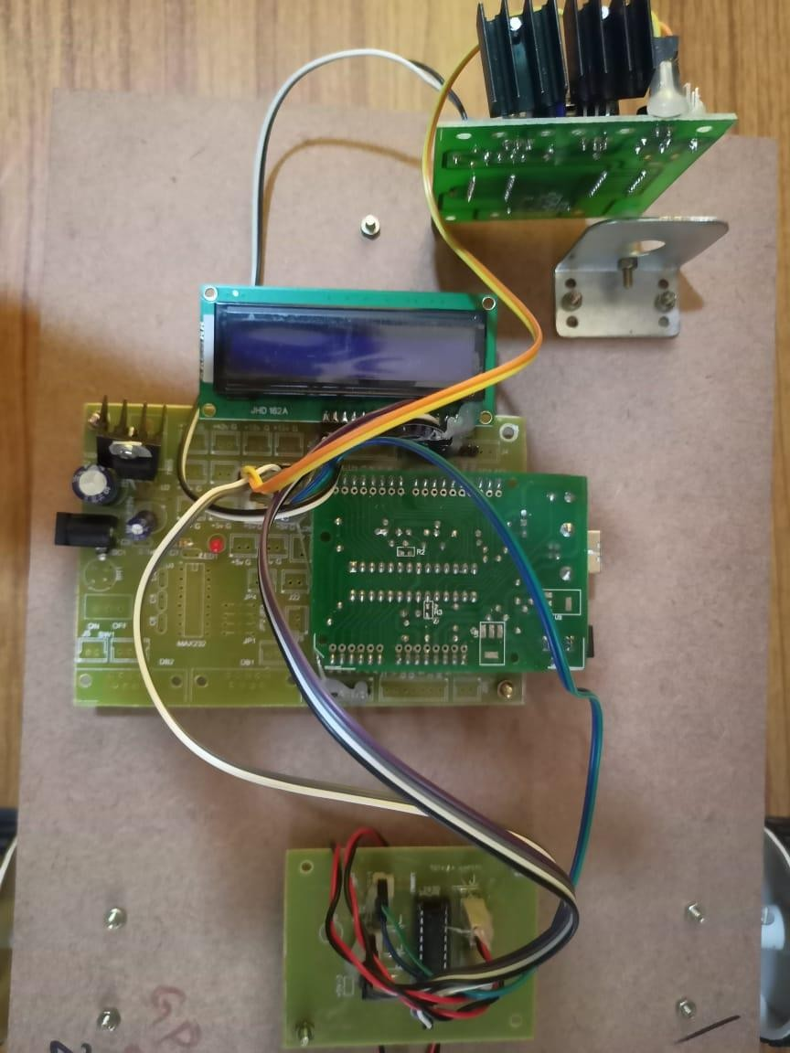
Experimental result:
Above shown is the robot circuitry. All the modules are connected accordingly and the circuit is now set to connect the mobile to Arduino through WI-FI module

Slide 27
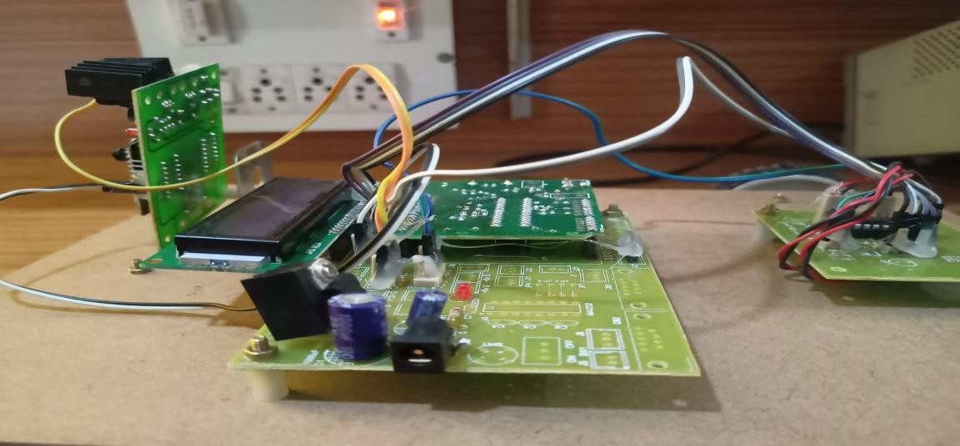
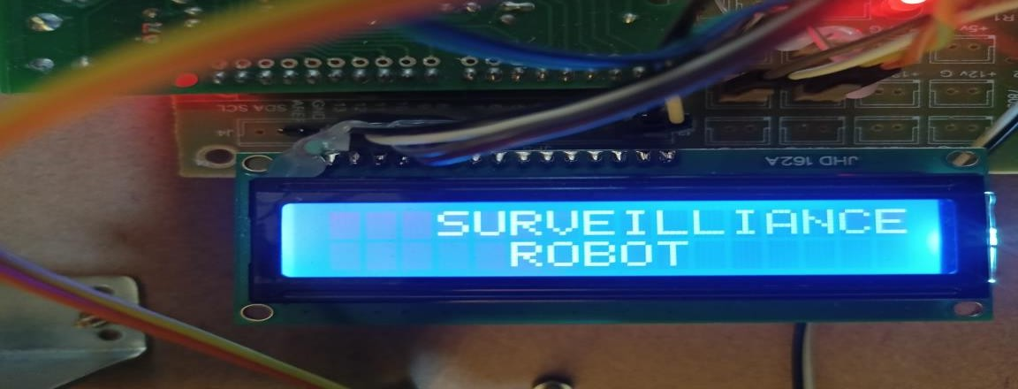
Figure 6.2 Connections
The blank display in LCD shows that the mobile is not yet connected to the respective WI-FI module.In this way there will be a clarity whether the circuit is connected properly to the WI-FI module or not.
Figure 6.3 Display of Title
The Title ‘SURVEILLANCE ROBOT” is displayed on the LCD after connecting mobile phone to Arduino.The programming is done in such a way that first “SURVEILLANCE ROBOT” is displayed immediately after connection.

Slide 28
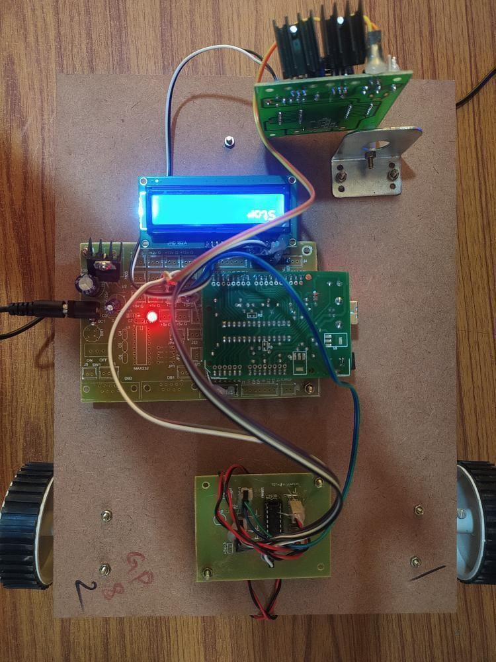
Figure 6.4 Robot Surveilliance Under Working Operation
All the modules are connected and the LCD is displaying the command that is being followed after connecting the mobile to Arduino through WI-FI module.

Slide 29
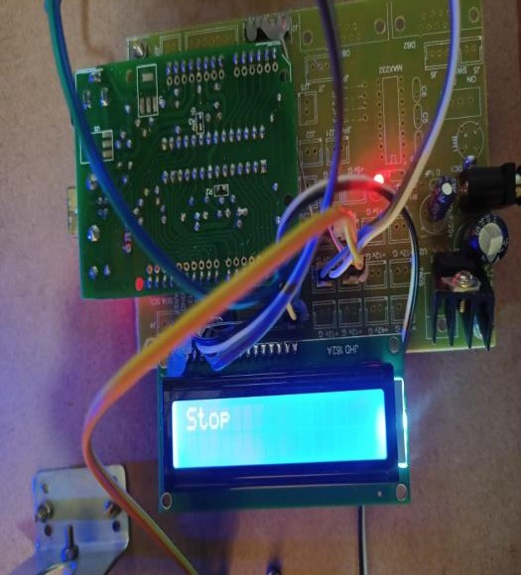
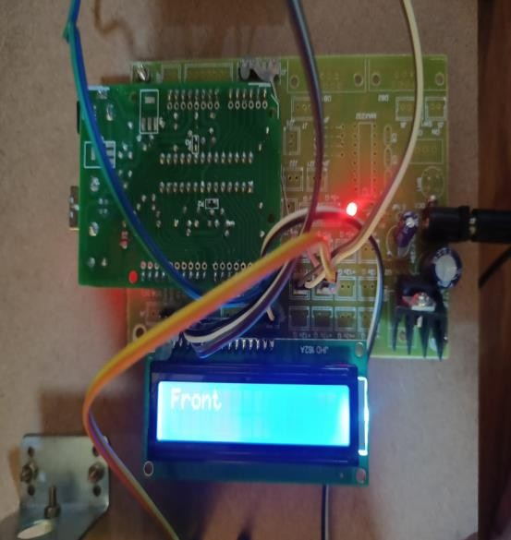
Figure 6.5 Display of commands
When the roboot is moving and the commands are followed, the robot immediately displays the command such as “STOP” ,”FRONT” etc…..

Slide 30
Applications
Following are the main applications of the IoT Surveillance Robot with Live Streaming:
By combining camera features with the robot we can easily monitor indoor as well as outdoor locations during daytime and at night.
Remote areas can also be explored.
Used to live-stream video output of the required environment.
It is capable carrying all kinds of military operations under all conditions without much involvement of the soldiers, thus saving the loss of lives and neutralizing any terrorists' activities.
It can be also useful in gathering information about the arms and ammunitions of the rivals, destroying them from a sufficient safe distance.
Not only in defense sector but also in disaster management it can be fruitful in managing the situations like flood, earthquakes etc.
Conclusion
In this project, the framework for making a robot for surveillance purpose based on Internet of Things is proposed. It overcomes the problem of limited range surveillance by using the concept of IoT. The robot is designed in such a way that one can control the robot with the help of laptop/mobile manually using its IP address. The main advantage of our proposed robot is that it is small in size which helps it entering into an area where human access is impossible. On the other hand, wireless technology is one of the most integral technologies in the electronics field. This robot uses this technology which makes it to cover unlimited path with no wires attached. The area or the range that the robot can be operated is determined by the Wi-Fi repeaters that can be arranged. The stronger the strength of the Wireless-Fidelity indicates a stronger communication between the robot and device that’s used to control the robot.This technology therefore is used to serve our project as a supreme part of surveillance act. Thus our project provides highly efficient and a cost effective robot that replaces human work and reduces human labour and performing monitoring works in a well effective manner.

Slide 31
Advantages
Cost Effectiveness
Improved Quality Assurance
Increased Productivity
Works In Hazardous Environments
Industrial safety and security system
Wireless data access through IoT
Robot control based surveillance
Efficient and low cost design.
Low power consumption.
Future Scope
There are lots of improvements that can be made on the current design and technology and lots of additional features can be added. The current autonomous navigation is a blind method where the robot doesn’t keep track of the direction and position of where it is heading. So in the future we would like to add an electronic compass for the robot to keep track of the direction. And a better method of cell based navigation can be done with the help of encoders for which a provision is provided. The architecture can also be modified by providing a more powerful embedded computer which could handle HTTP requests within the robot itself. After successfully manufacturing our robot and arm, and programming the same according to our needs, we tested the following things:
If this prototype were to be realized actually by the defense ministry, it could do with a lot of modifications like:
Mobility on the ground
Image processing
Installation of more cameras will give a 360 degree view.
Temperature detection

